Slide 1
EQUIPMENT’S CLASSROOM MANAGEMENT
Group 10:
Trần Vĩnh Quang – SE61078
Tăng Việt Hưng – SE61019
Đoàn Nguyễn Minh Chí – SE60717
Supervisor:
Kiều Trọng Khánh

Slide 2
OUTLINE
Current Situation
Solution
Demonstration
Advantages and Disadvantages
Future plan
Question and Answers

Slide 3


CURRENT SITUATION
Staff

Slide 4

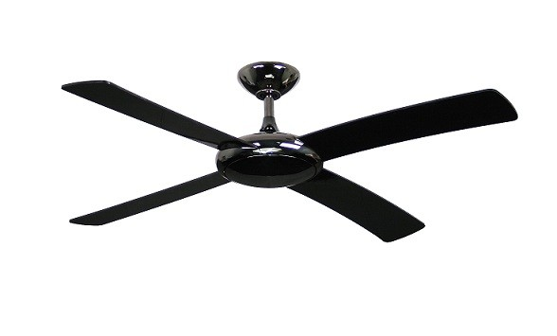
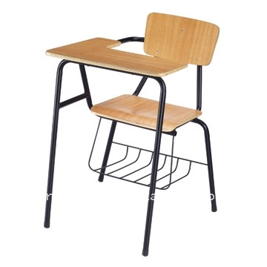
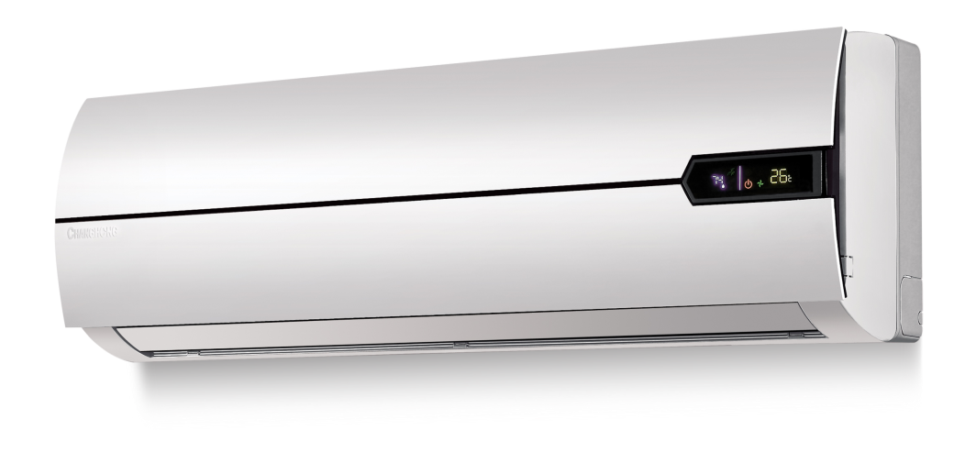
CURRENT SITUATION

Slide 5
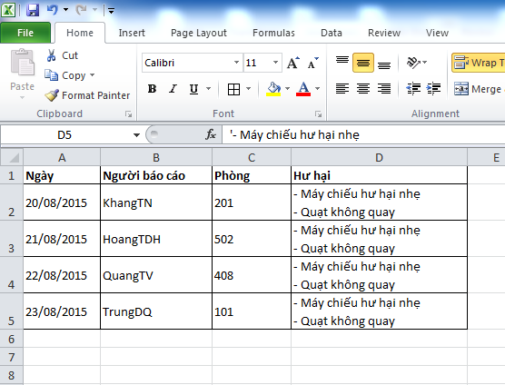
CURRENT SITUATION

Slide 6


CURRENT SITUATION
1

Slide 7
CURRENT SITUATION
1
2

Slide 8
CURRENT SITUATION
3
1
2

Slide 9

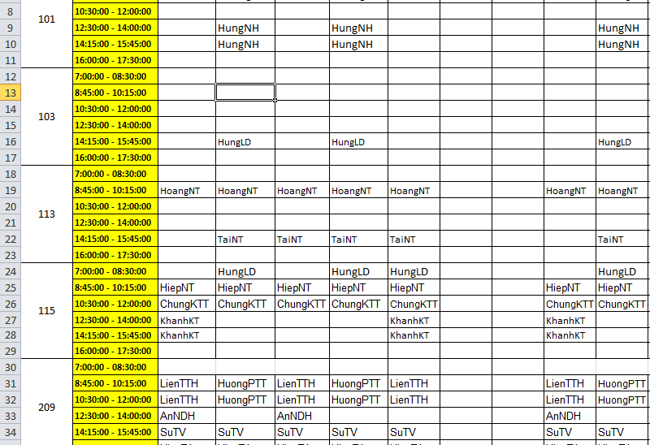
CURRENT SITUATION
3
1
2
4

Slide 10
CURRENT SITUATION
3
1
2
4
5

Slide 11
CURRENT SITUATION
3
1
2
4
6
5

Slide 12
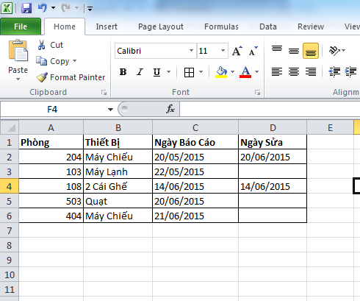

CURRENT SITUATION
7
8

Slide 13
CURRENT SITUATION
1
Managing equipment is manual
2
Waste time when receive and resolve report
3
Hard to notice when needed
4
Require human resource

Slide 14
SOLUTION
ECRM
Teacher

Slide 15
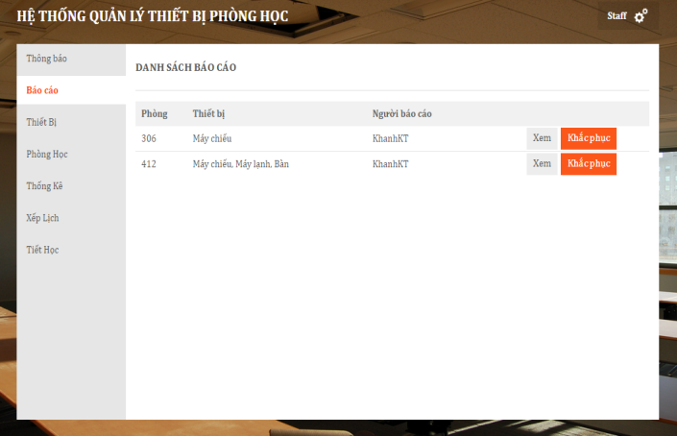
SOLUTION
ECRM

Slide 16
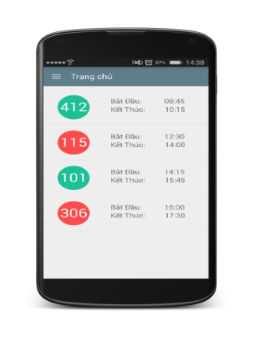
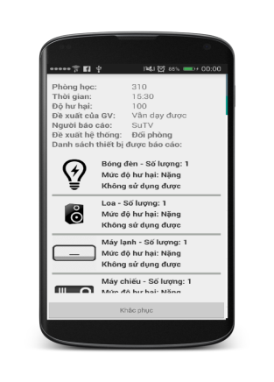
SOLUTION
ECRM

Slide 17
SOLUTION
ECRM

Slide 18
1
ECRM

Slide 19
Manage Equipment
3
2
1
ECRM

Slide 20
Manage Equipment
3
2
1
4
ECRM

Slide 21
Manage Equipment
3
2
1
4
ECRM
5

Slide 22
Manage Equipment
Manage Equipment
3
2
1
4
ECRM
ECRM
5
6
21

Slide 23
SOLUTION
Managing equipment is automatic
ECRM

Slide 24
SOLUTION
Managing equipment is automatic
Automatic receive and analyze data report => System makes decisions.
ECRM

Slide 25
SOLUTION
Managing equipment is automatic
Automatic receive and analyze data report => System makes decisions.
ECRM
Notice based on SMS and notification in real time

Slide 26
SOLUTION
Managing equipment is automatic
Automatic receive and analyze data report => System makes decisions.
ECRM
Notice based on SMS and notification in real time
Require less human resource

Slide 27
CLASSROOM
CLASSROOM OBJECT
ClassName
NumberSlot

Slide 28
CLASSROOM
CLASSROOM OBJECT
ClassName
NumberSlot
EQUIPMENT CATEGORY OBJECT
ClassName
Name
0.. *
0.. *

Slide 29
CLASSROOM
ROOMTYPE OBJECT
CLASSROOM OBJECT
ClassName
NumberSlot
EQUIPMENT CATEGORY OBJECT
Name

Slide 30
CLASSROOM
ROOMTYPE OBJECT
RoomTypeId
1..1
CLASSROOM OBJECT
ClassName
NumberSlot
RoomTypeId
EQUIPMENT CATEGORY OBJECT
Name
0..*

Slide 31
CLASSROOM
ROOMTYPE OBJECT
RoomTypeId
1..1
0..*
CLASSROOM OBJECT
ClassName
NumberSlot
RoomTypeId
EQUIPMENT CATEGORY OBJECT
Name
1..*
0..*

Slide 32
CLASSROOM
ROOMTYPE OBJECT
RoomTypeId
1..1
0..*
CLASSROOM OBJECT
ClassName
NumberSlot
RoomTypeId
EQUIPMENT CATEGORY OBJECT
Name
1..*
0..*

Slide 33
CLASSROOM
EQUIPMENT QUANTITY OBJECT
RoomTypeID
EquipmentName
Quantity
Priority
0..*
0..*
EQUIPMENT CATEGORY OBJECT
Name
ROOMTYPE OBJECT
RoomTypeID
1..1
1..1

Slide 34
CLASSROOM
CLASSROOM OBJECT
ClassName
NumberSlot
RoomTypeID

Slide 35
CLASSROOM
CLASSROOM OBJECT
ClassName
NumberSlot
RoomTypeID
ROOMTYPE OBJECT
RoomTypeID
0..*
1..1

Slide 36
CLASSROOM
CLASSROOM OBJECT
ClassName
NumberSlot
RoomTypeID
ROOMTYPE OBJECT
RoomTypeID
0..*
1..1
1..1
0..*
EQUIPMENT QUANTITY OBJECT
RoomTypeID
EquipmentName
Quantity
Priority

Slide 37
CLASSROOM
CLASSROOM OBJECT
ClassName
NumberSlot
RoomTypeID
ROOMTYPE OBJECT
RoomTypeID
0..*
1..1
1..1
0..*
EQUIPMENT QUANTITY OBJECT
RoomTypeID
EquipmentName
Quantity
Priority
EQUIPMENT CATEGORY OBJECT
Name
1..1
0..*

Slide 38
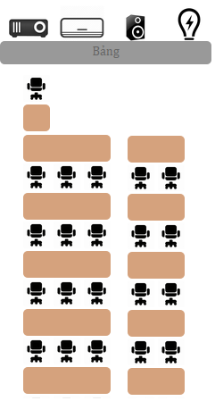

ROOM TYPE

Slide 39
ROOM TYPE
ROOMTYPE OBJECT
RoomTypeID
Name
VerticalRows

Slide 40
ROOM TYPE
ROOMTYPE OBJECT
RoomTypeID
Name
VerticalRows
HorizontalRows

Slide 41
ROOM TYPE
ROOMTYPE OBJECT
RoomTypeID
Name
VerticalRows
HorizontalRows
NumberOfSlotsEachHRows

Slide 42
ROOM TYPE
ROOMTYPE OBJECT
RoomTypeID
Name
VerticalRows
HorizontalRows
NumberOfSlotsEachHRows
1..1
0..*
EQUIPMENT QUANTITY OBJECT
RoomTypeID
EquipmentName

Slide 43
SCHEDULE
Update equipment using time
Why need schedule ?

Slide 44
SCHEDULE
Update equipment using time
Why need schedule ?
Find available room when needed

Slide 45
SCHEDULE
Update equipment using time
Why need schedule ?
Find available room when needed
Check report of user

Slide 46
SCHEDULE
SCHEDULE OBJECT
Username
ClassName
ScheduleConfigID
Date
SCHEDULE CONFIG OBJECT
Slot
TimeFrom
TimeTo
0..*
1..1

Slide 47

REPORT DAMAGED EQUIPMENT

Slide 48
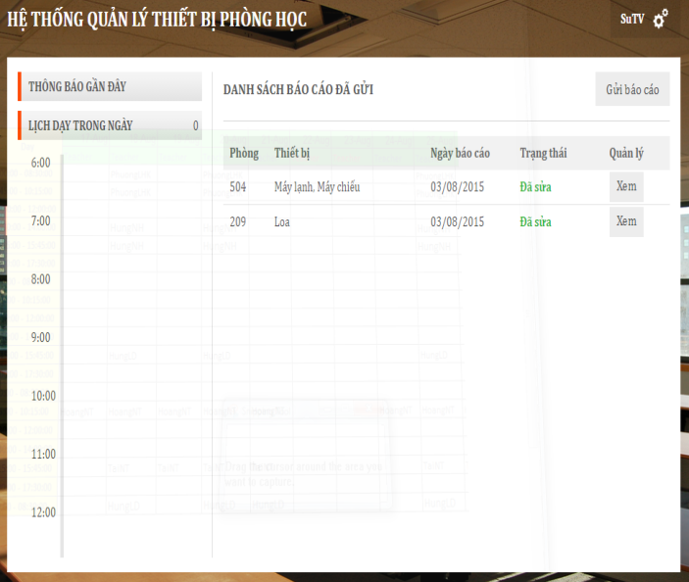
REPORT DAMAGED EQUIPMENT

Slide 49

REPORT DAMAGED EQUIPMENT

Slide 50


REPORT DAMAGED EQUIPMENT
Save data to database
1
2

Slide 51
REPORT DAMAGED EQUIPMENT
Notify to staff
3
1
2

Slide 52

REPORT DAMAGED EQUIPMENT
Analyze data from report
3
1
4
2

Slide 53
REPORT DAMAGED EQUIPMENT
Send notification to teacher
3
1
4
6
5
2

Slide 54

REPORT DAMAGED EQUIPMENT
Send notification to another teacher
3
1
4
6
5
2
7

Slide 55
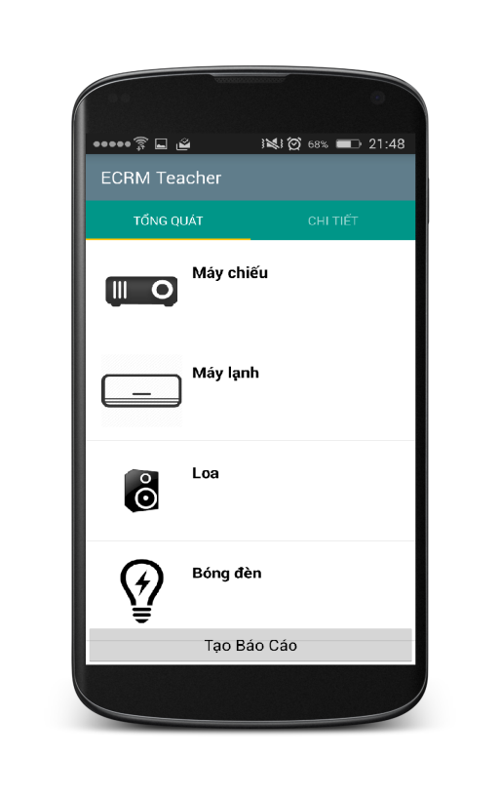
REPORT DAMAGED EQUIPMENT
Create report

Slide 56
REPORT DAMAGED EQUIPMENT
REPORT OBJECT
Username
ClassName
Evaluate
Date
1..1
0..*
REPORT DETAIL OBJECT
EquipmentName
DamageLevel
Evaluate

Slide 57
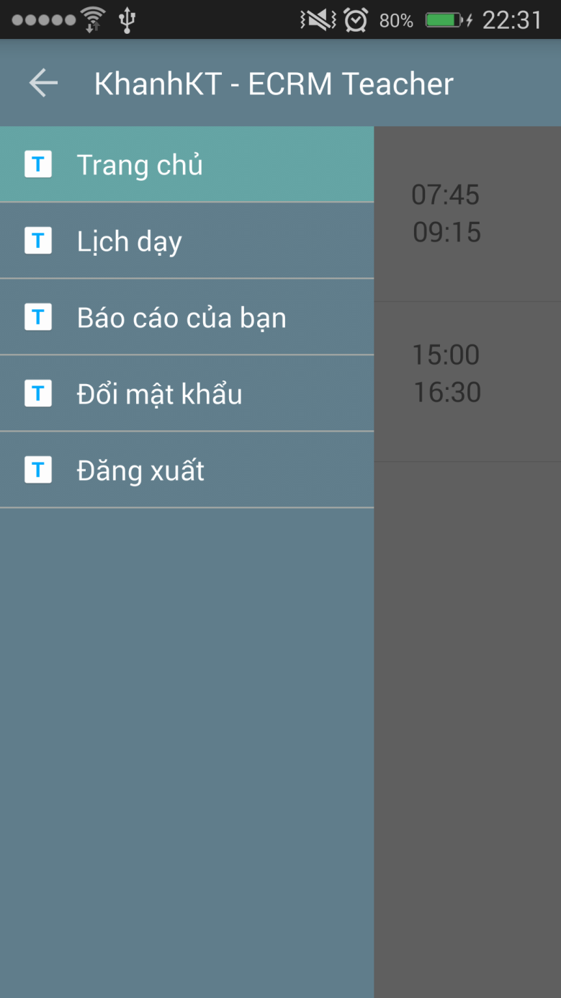
REPORT DAMAGED EQUIPMENT
REPORT OBJECT
Username
ClassName
Evaluate
Date
1..1
0..*
REPORT DETAIL OBJECT
EquipmentName
DamageLevel
Evaluate

Slide 58
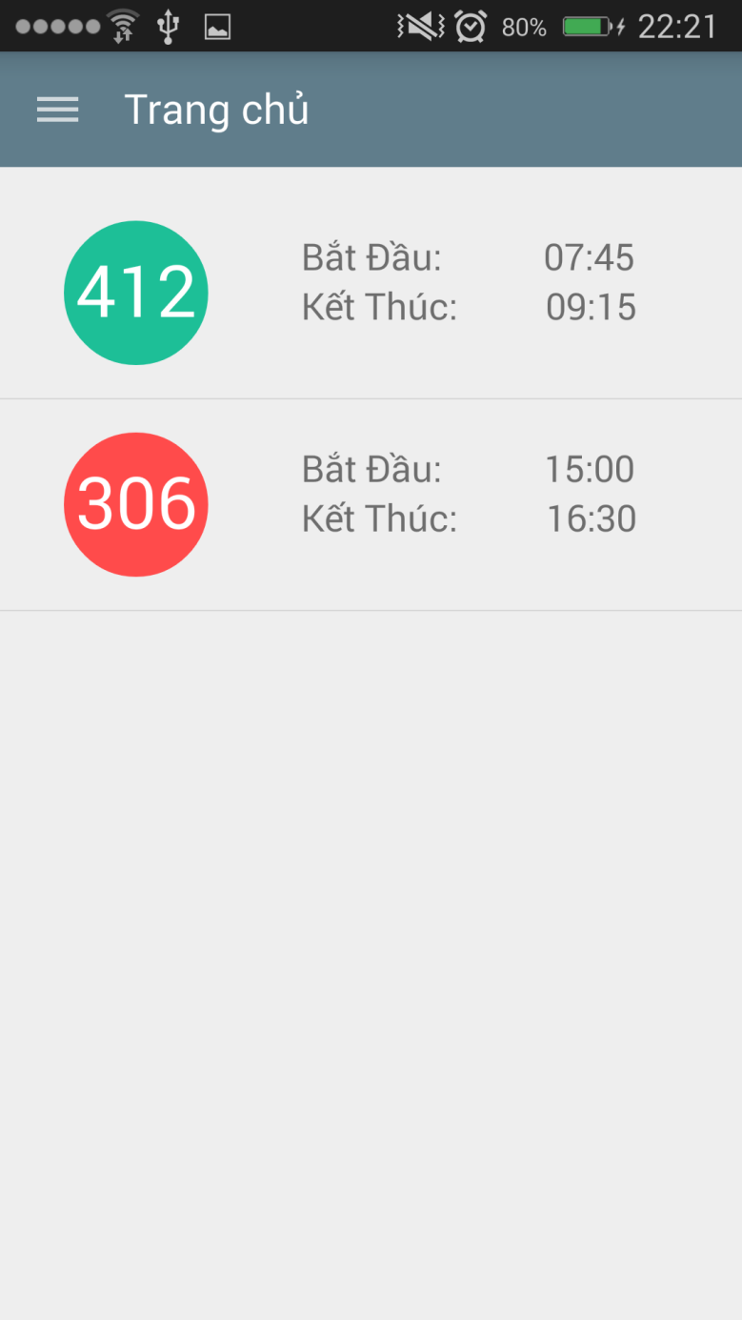
REPORT DAMAGED EQUIPMENT
REPORT OBJECT
Username
ClassName
Evaluate
Date
1..1
0..*
REPORT DETAIL OBJECT
EquipmentName
DamageLevel
Evaluate

Slide 59
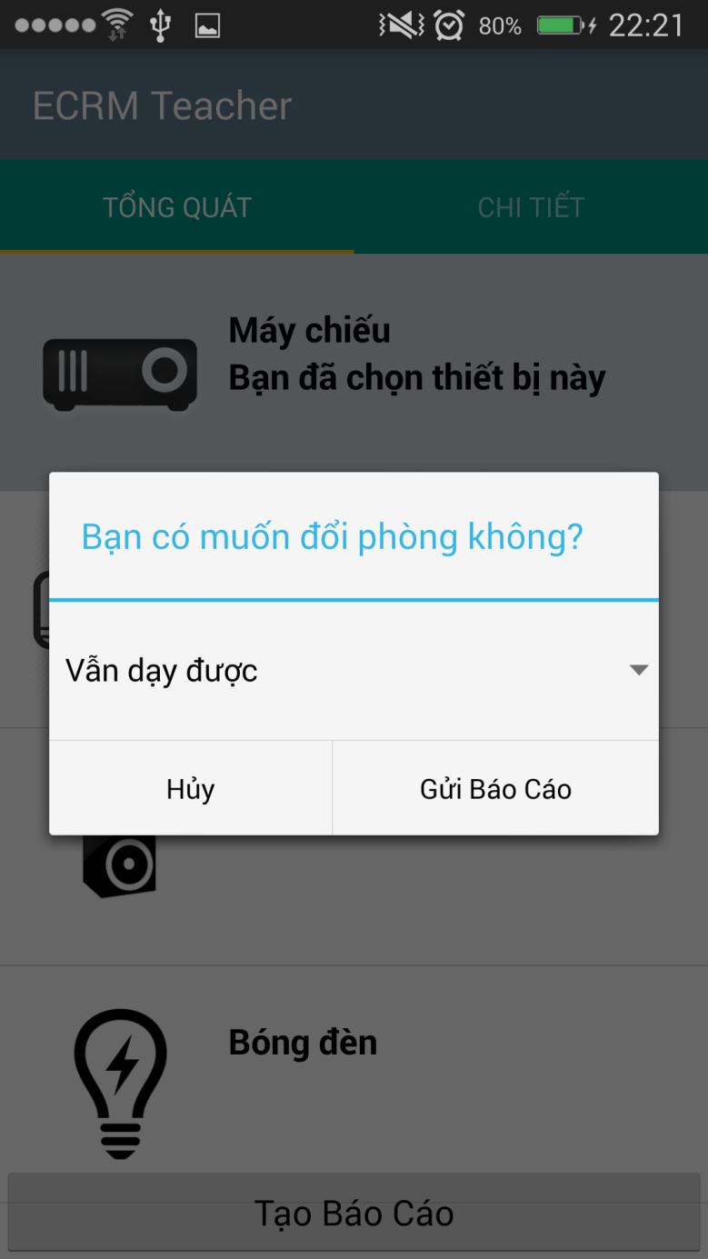
REPORT DAMAGED EQUIPMENT
REPORT OBJECT
Username
ClassName
Evaluate
Date
1..1
0..*
REPORT DETAIL OBJECT
EquipmentName
DamageLevel
Evaluate

Slide 60
REPORT DAMAGED EQUIPMENT
REPORT OBJECT
Username
ClassName
Evaluate
Date
Current server time
1..1
0..*
REPORT DETAIL OBJECT
EquipmentName
DamageLevel
Evaluate

Slide 61
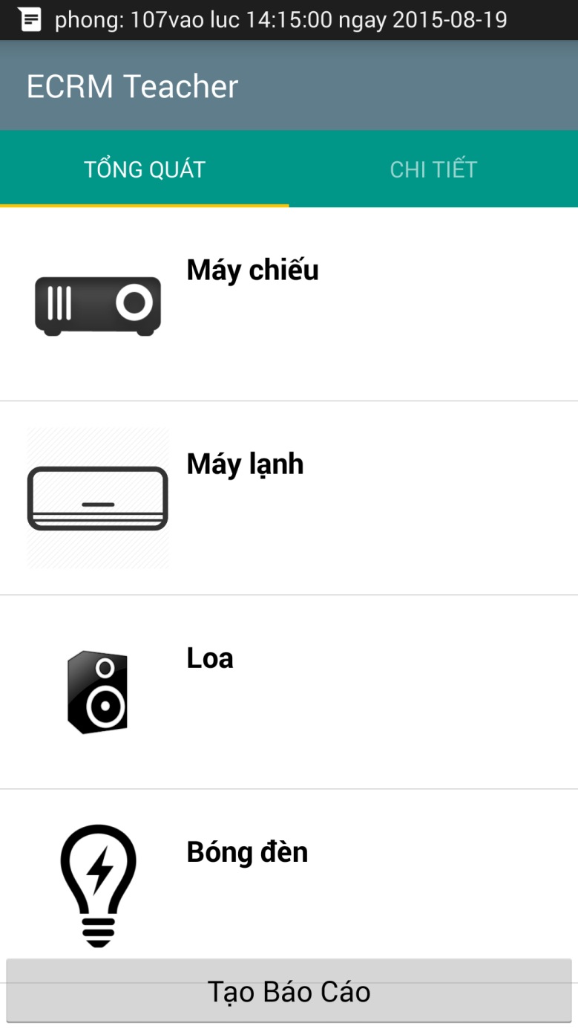
REPORT DAMAGED EQUIPMENT
REPORT OBJECT
Username
ClassName
Evaluate
Date
1..1
0..*
REPORT DETAIL OBJECT
EquipmentName
DamageLevel
Evaluate

Slide 62
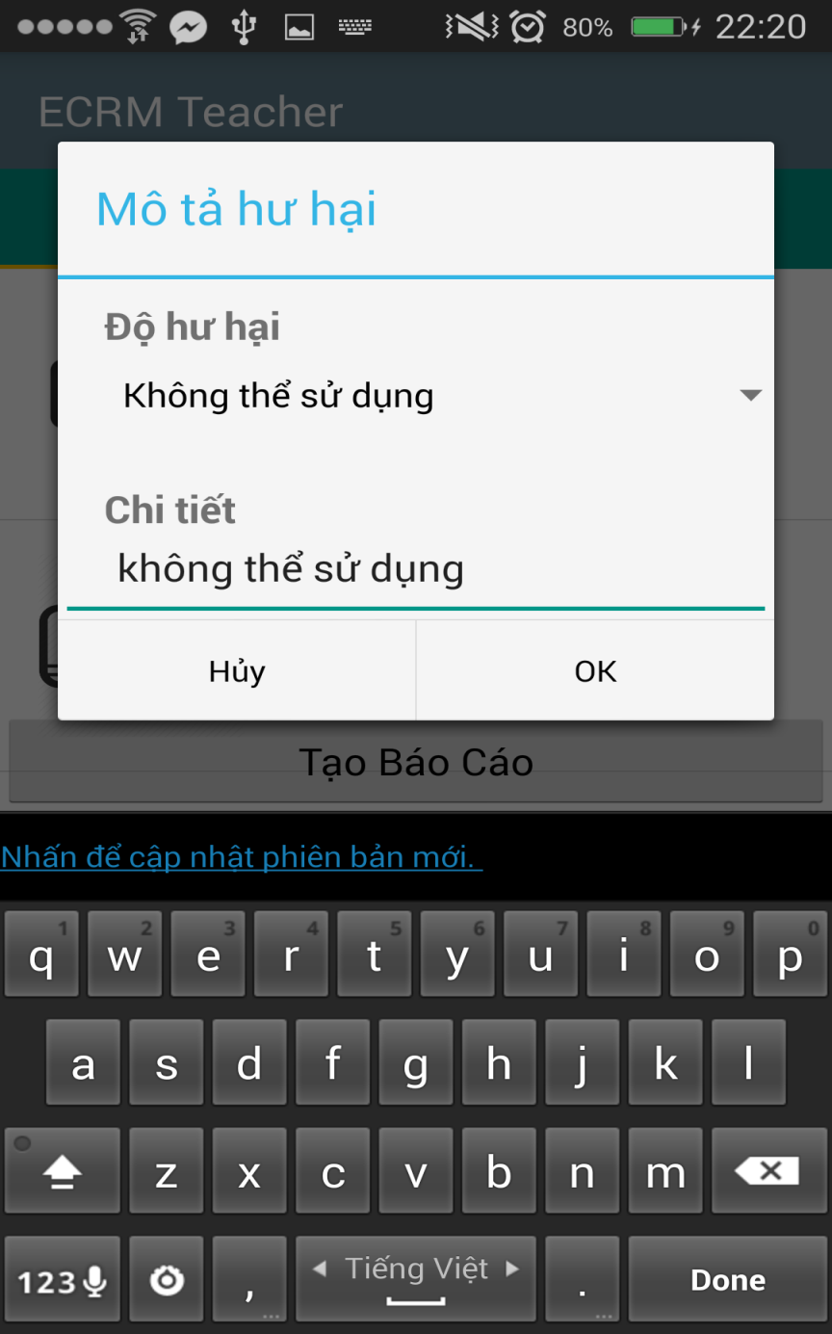
REPORT DAMAGED EQUIPMENT
REPORT OBJECT
Username
ClassName
Evaluate
Date
1..1
0..*
REPORT DETAIL OBJECT
EquipmentName
DamageLevel
Evaluate

Slide 63
REPORT DAMAGED EQUIPMENT
REPORT OBJECT
Username
ClassName
Evaluate
Date
1..1
0..*
REPORT DETAIL OBJECT
EquipmentName
DamageLevel
Evaluate

Slide 64
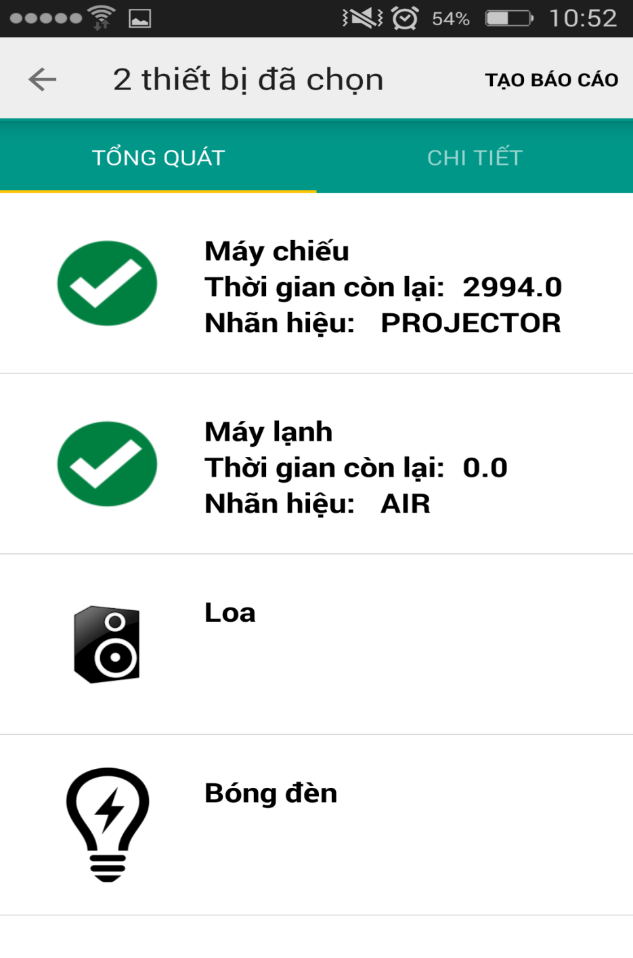
REPORT DAMAGED EQUIPMENT
REPORT OBJECT
Username
ClassName
Evaluate
Date
1..1
0..*
REPORT DETAIL OBJECT
EquipmentName
DamageLevel
Evaluate

Slide 65
ANALYZE DATA AND MAKING DECISION

Slide 66
ANALYZE DATA AND MAKING DECISION
REPORT OBJECT
Username
ClassName
Evaluate
Date
1..1
0..*
REPORT DETAIL OBJECT
EquipmentName
DamageLevel
Evaluate

Slide 67
ANALYZE DATA AND MAKING DECISION
REPORT OBJECT
Username
ClassName
Evaluate
Date
ROOM TYPE OBJECT
NoSlots
List Equipments
List Equipment’s Priority
1..1
0..*
REPORT DETAIL OBJECT
EquipmentName
DamageLevel
Evaluate

Slide 68

ANALYZE DATA AND MAKING DECISION

Slide 69
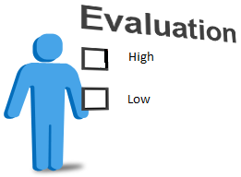
ANALYZE DATA AND MAKING DECISION

Slide 70

ANALYZE DATA AND MAKING DECISION
High
Medium
Low

Slide 71
ANALYZE DATA AND MAKING DECISION
High
Medium
Low
Damaged level

Slide 72

ANALYZE DATA AND MAKING DECISION
REPORT

Slide 73
ANALYZE DATA AND MAKING DECISION
REPORT
ROOM TYPE

Slide 74
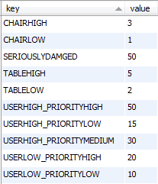
ANALYZE DATA AND MAKING DECISION
REPORT
Step 1:
Analyze data
Evaluate is “Không thể sử dụng”
CONFIGURATION
ROOM TYPE
Priority is “Cao”

Slide 75
ANALYZE DATA AND MAKING DECISION
REPORT
Step 1:
Analyze data
50
CONFIGURATION
ROOM TYPE

Slide 76
ANALYZE DATA AND MAKING DECISION
REPORT
Step 1:
Analyze data
50
CONFIGURATION
Evaluate is “Có thể sử dụng”
ROOM TYPE
Priority is “Thấp”

Slide 77
ANALYZE DATA AND MAKING DECISION
REPORT
Step 1:
Analyze data
50
CONFIGURATION
10
ROOM TYPE

Slide 78
ANALYZE DATA AND MAKING DECISION
REPORT
50
CONFIGURATION
10
ROOM TYPE
60

Slide 79
ANALYZE DATA AND MAKING DECISION
Step 2:
Making decision

Slide 80
ANALYZE DATA AND MAKING DECISION
Step 2:
Making decision
CONFIGURATION
Get seriously damaged in database

Slide 81
ANALYZE DATA AND MAKING DECISION
Step 2:
Making decision
Get seriously damaged in database
Is damage level larger than seriously damaged?

Slide 82
ANALYZE DATA AND MAKING DECISION
Step 2:
Making decision
Get seriously damaged in database
Is damaged level larger than seriously damaged?
NO
YES
Find available room and change room
Update damaged for classroom. Finish.

Slide 83
CLASSROOM’S STATUS
Normal
(Bình thường)
Damaged level = 0
Damaged
(Hư hại)
0 < Damaged level < seriously damaged
Seriously Damaged
(Hư hại nghiêm trọng)
Damaged level >= seriously damaged
Removed
(Bị xóa)
Staff removed classroom

Slide 84
Normal
Damaged
Removed
Seriously Damaged

Slide 85
Normal
Damaged
Staff remove classroom
Removed
Seriously Damaged

Slide 86
0 < Damaged level < seriously damaged
Normal
Damaged
Staff resolves all report
Staff remove classroom
Removed
Seriously Damaged

Slide 87
0 < Damaged level < seriously damaged
Normal
Damaged
Staff resolves all report
Staff remove classroom
Damaged level >= seriously damaged
Staff resolves all report
Removed
Seriously Damaged

Slide 88
0 < Damaged level < seriously damaged
Normal
Damaged
Staff resolves all report
Staff remove classroom
Damaged level >= seriously damaged
Damaged level >= seriously damaged
Staff resolves all report
0 < Damaged level < seriously damaged
Removed
Seriously Damaged

Slide 89
FIND AVAILABLE ROOM
Start

Slide 90
FIND AVAILABLE ROOM
Start
1
Get list normal classroom

Slide 91
FIND AVAILABLE ROOM
Start
1
Get list normal classroom
2
Compare schedule

Slide 92
FIND AVAILABLE ROOM
Start
1
Get list normal classroom
2
Compare schedule
3
Get list available room

Slide 93
FIND AVAILABLE ROOM
Start
1
Get list normal classroom
2
Compare schedule
3
Get list available room
4
Sort by floor

Slide 94
FIND AVAILABLE ROOM
Start
1
Get list normal classroom
2
Compare schedule
3
Get list available room
4
Sort by floor
5
Compare room type

Slide 95
FIND AVAILABLE ROOM
Start
1
Get list normal classroom
2
Compare schedule
3
Get list available room
4
Sort by floor
5
Compare room type
6
Return room

Slide 96
FIND AVAILABLE ROOM
Start
1
Get list normal classroom
2
Compare schedule
3
Get list available room
4
Sort by floor
5
6
7
Compare room type
Return room
Finish

Slide 97
FIND AVAILABLE ROOM
Class Name: 302
Room Type: “Thông Dụng” with 30 slots, 2 air conditioner

Slide 98
FIND AVAILABLE ROOM
Step 1:
Get normal classrooms
202
303
201
301
402
101
503
List normal classrooms

Slide 99
FIND AVAILABLE ROOM
Step 2:
Sort by floor
Class Name: 302
202
303
201
301
402
101
503
List normal classrooms

Slide 100
FIND AVAILABLE ROOM
Step 2:
Sort by floor
Class Name: 302
Sort
202
303
201
301
402
101
503
301
List normal classrooms

Slide 101
FIND AVAILABLE ROOM
Step 2:
Sort by floor
Class Name: 302
Sort
202
303
201
301
402
101
503
301
303
List normal classrooms

Slide 102
FIND AVAILABLE ROOM
Step 2:
Sort by floor
Class Name: 302
Sort
202
303
201
301
402
101
503
301
303
201
List normal classrooms

Slide 103
FIND AVAILABLE ROOM
Step 2:
Sort by floor
Class Name: 302
Sort
202
303
201
301
402
101
503
301
303
201
202
List normal classrooms

Slide 104
FIND AVAILABLE ROOM
Step 2:
Sort by floor
Class Name: 302
Sort
202
303
201
301
402
101
503
301
303
201
202
402
List normal classrooms

Slide 105
FIND AVAILABLE ROOM
Step 2:
Sort by floor
Class Name: 302
Sort
202
303
201
301
402
101
503
301
303
201
202
402
101
List normal classrooms

Slide 106
FIND AVAILABLE ROOM
Step 2:
Sort by floor
Class Name: 302
Sort
202
303
201
301
402
101
503
301
303
201
202
402
101
503
List normal classrooms
List sort by floor

Slide 107
FIND AVAILABLE ROOM
Step 3:
Compare with room type
Room Type: “Thông Dụng” with 30 slots, 2 air conditioner,…
301
303
201
202
402
101
503
List sort by floor

Slide 108
FIND AVAILABLE ROOM
Step 3:
Compare with room type
Room Type: “Thông Dụng” with 30 slots, 2 air conditioner,…
Compare
301
303
201
202
402
101
503
301
303
201
202
402
101
503
List sort by floor
Room Type is “Thông Dụng”

Slide 109
FIND AVAILABLE ROOM
Step 3:
Compare with room type
Room Type: “Thông Dụng” with 30 slots, 2 air conditioner,…
Compare
301
303
201
202
402
101
503
503
301
303
201
202
402
101
List sort by floor
Room Type is “Thông Dụng”

Slide 110
FIND AVAILABLE ROOM
Step 3:
Compare with room type
Room Type: “Thông Dụng” with 30 slots, 2 air conditioner,…
Compare
301
303
201
202
402
101
503
503
301
303
201
202
402
101
List sort by floor
Room Type is smaller than current Room Type

Slide 111
FIND AVAILABLE ROOM
Step 3:
Compare with room type
Room Type: “Thông Dụng” with 30 slots, 2 air conditioner,…
Compare
301
303
201
202
402
101
503
402
503
301
303
201
202
101
List sort by floor
Room Type is equal current Room Type

Slide 112
FIND AVAILABLE ROOM
Step 3:
Compare with room type
Room Type: “Thông Dụng” with 30 slots, 2 air conditioner,…
Compare
301
303
201
202
402
101
503
202
402
503
301
303
201
101
List sort by floor
Room Type is larger current Room Type

Slide 113
FIND AVAILABLE ROOM
Step 3:
Compare with room type
Room Type: “Thông Dụng” with 30 slots, 2 air conditioner,…
Compare
301
303
201
202
402
101
503
202
402
503
301
303
201
101
List sort by floor
Room Type is smaller than current Room Type

Slide 114
FIND AVAILABLE ROOM
Step 3:
Compare with room type
Room Type: “Thông Dụng” with 30 slots, 2 air conditioner,…
Compare
301
303
201
202
402
101
503
202
402
503
301
303
201
101
List sort by floor
Room Type is smaller than current Room Type

Slide 115
FIND AVAILABLE ROOM
Step 3:
Compare with room type
Room Type: “Thông Dụng” with 30 slots, 2 air conditioner,…
Compare
301
303
201
202
402
101
503
202
402
503
301
303
201
101
List sort by floor
Room Type is smaller than current Room Type

Slide 116
FIND AVAILABLE ROOM
Step 3:
Compare with room type
Room Type: “Thông Dụng” with 30 slots, 2 air conditioner,…
Compare
301
303
201
202
402
101
503
202
402
503
301
303
201
101
List sort by floor
List after compare

Slide 117
FIND AVAILABLE ROOM
Class Name: 302
Room Type: “Thông Dụng” with 30 slots, 2 air conditioner…
202
402
503
301
303
201
101
202
Result
List after compare

Slide 118
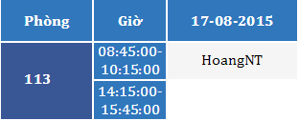

SCENARIO PROBLEM 1
Mr. HoangNT

Slide 119

SCENARIO PROBLEM 1
17-08-2015
09:00 AM
Classroom 113
Projector: “Không thể sử dụng được”
Air conditioning: “Không thể sử dụng được”
Mr. HoangNT

Slide 120

SCENARIO PROBLEM 1
17-08-2015
09:00 AM
Classroom 113
Projector: “Không thể sử dụng được”
Air conditioning: “Không thể sử dụng được”
Mr. HoangNT

Slide 121
SCENARIO PROBLEM 1
17-08-2015
09:00 AM
Classroom 113
Projector: “Không thể sử dụng được”
Air conditioning: “Không thể sử dụng được”
Mr. HoangNT
Analyze data
Classroom 113
Damaged Level: 80%
IsDamaged: true

Slide 122
SCENARIO PROBLEM 1
17-08-2015
09:00 AM
Classroom 113
Projector: “Không thể sử dụng được”
Air conditioning: “Không thể sử dụng được”
Mr. HoangNT
Analyze data
Classroom 113
Damaged Level: 0%
IsDamaged: False
Classroom 113
Damaged Level: 80%
IsDamaged: true
Normal
Seriously Damaged

Slide 123
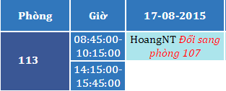
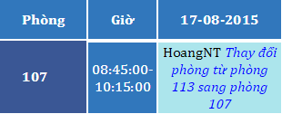
SCENARIO PROBLEM 1
17-08-2015
09:00 AM
Classroom 113
Projector: “Không thể sử dụng được”
Air conditioning: “Không thể sử dụng được”
Mr. HoangNT
Analyze data
Classroom 113
Damaged Level: 80%
IsDamaged: true

Slide 124
SCENARIO PROBLEM 1
17-08-2015
09:00 AM
Classroom 113
Projector: “Không thể sử dụng được”
Air conditioning: “Không thể sử dụng được”
Mr. HoangNT
Analyze data
Classroom 113
Damaged Level: 80%
IsDamaged: true

Slide 125
DEMONSTRATION

Slide 126
CHECK STATUS OF CLASSROOM
Time:
06:30 AM - 12:15 PM Every day
Actor:
Scheduler
Goal:
Checking current status of classroom
Make decision when needed

Slide 127
CHECK STATUS OF CLASSROOM
Step 1
Get all classrooms are damaged

Slide 128
CHECK STATUS OF CLASSROOM
Step 1
Get all classrooms are damaged
Step 2
Find available room to change

Slide 129
CHECK STATUS OF CLASSROOM
Step 1
Get all classrooms are damaged
Step 2
Find available room to change
Step 3
Change room and notice to teacher

Slide 130
SCENARIO PROBLEM 2
17-08-2015
09:00 AM
Classroom 113
Projector: “Không thể sử dụng được”
Air conditioning: “Không thể sử dụng được”
Mr. HoangNT
18-08-2015
06:30 AM
Classroom 113
Damaged Level: 80%
IsDamaged: true

Slide 131
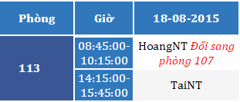
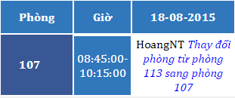
SCENARIO PROBLEM 2
17-08-2015
09:00 AM
Classroom 113
Projector: “Không thể sử dụng được”
Air conditioning: “Không thể sử dụng được”
Mr. HoangNT
18-08-2015
06:30 AM
Classroom 113
Damaged Level: 80%
IsDamaged: true

Slide 132
SCENARIO PROBLEM 2
17-08-2015
09:00 AM
Classroom 113
Projector: “Không thể sử dụng được”
Air conditioning: “Không thể sử dụng được”
Mr. HoangNT
18-08-2015
06:30 AM
Classroom 113
Damaged Level: 80%
IsDamaged: true

Slide 133
DEMONSTRATION

Slide 134
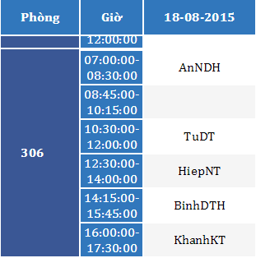

SCENARIO PROBLEM 3
Mr. AnNDH

Slide 135
SCENARIO PROBLEM 3
18-08-2015
08:15 AM
Classroom 306
Projector: “Không thể sử dụng được”
Mr. AnNDH

Slide 136
SCENARIO PROBLEM 3
18-08-2015
08:15 AM
Classroom 306
Projector: “Không thể sử dụng được”
Mr. AnNDH

Slide 137
SCENARIO PROBLEM 3
18-08-2015
08:15 AM
Classroom 306
Projector: “Không thể sử dụng được”
Mr. AnNDH
Analyze data
Classroom 306
Damaged Level: 50%
IsDamaged: true

Slide 138
SCENARIO PROBLEM 3
18-08-2015
08:15 AM
Classroom 306
Projector: “Không thể sử dụng được”
Mr. AnNDH
Analyze data
Classroom 306
Damaged Level: 50%
IsDamaged: true
Classroom 306
Damaged Level: 0%
IsDamaged: False
Normal
Seriously Damaged

Slide 139
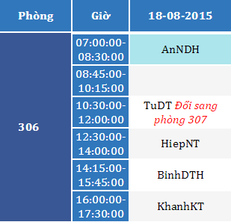
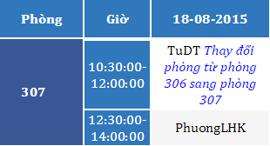
SCENARIO PROBLEM 3
18-08-2015
08:15 AM
Classroom 306
Projector: “Không thể sử dụng được”
Mr. AnNDH
Analyze data
Classroom 306
Damaged Level: 50%
IsDamaged: true

Slide 140
SCENARIO PROBLEM 3
18-08-2015
08:15 AM
Classroom 306
Projector: “Không thể sử dụng được”
Mr. AnNDH
Analyze data
Classroom 306
Damaged Level: 50%
IsDamaged: true

Slide 141
SCENARIO PROBLEM 3
18-08-2015
08:15 AM
Classroom 306
Projector: “Không thể sử dụng được”
Mr. AnNDH
18-08-2015
12:15 PM
Classroom 306
Damaged Level: 50%
IsDamaged: true

Slide 142
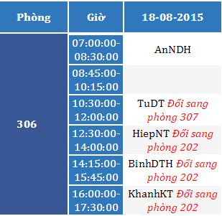
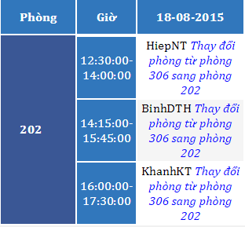
SCENARIO PROBLEM 3
18-08-2015
08:15 AM
Classroom 306
Projector: “Không thể sử dụng được”
Mr. AnNDH
18-08-2015
12:15 PM
Classroom 306
Damaged Level: 50%
IsDamaged: true

Slide 143
SCENARIO PROBLEM 3
18-08-2015
08:15 AM
Classroom 306
Projector: “Không thể sử dụng được”
Mr. AnNDH
18-08-2015
12:15 PM
Classroom 306
Damaged Level: 50%
IsDamaged: true

Slide 144
SCENARIO PROBLEM 3
18-08-2015
08:15 AM
Classroom 306
Projector: “Không thể sử dụng được”
Mr. AnNDH
19-08-2015
06:30 AM
Classroom 306
Damaged Level: 50%
IsDamaged: true

Slide 145
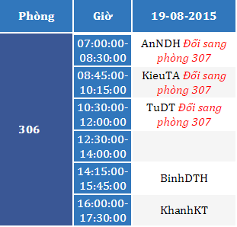
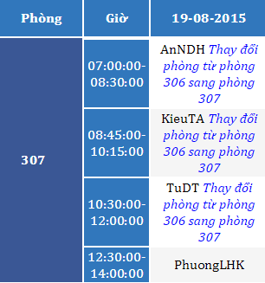
SCENARIO PROBLEM 3
18-08-2015
08:15 AM
Classroom 306
Projector: “Không thể sử dụng được”
Mr. AnNDH
19-08-2015
06:30 AM
Classroom 306
Damaged Level: 50%
IsDamaged: true

Slide 146
SCENARIO PROBLEM 3
18-08-2015
08:15 AM
Classroom 306
Projector: “Không thể sử dụng được”
Mr. AnNDH
19-08-2015
06:30 AM
Classroom 306
Damaged Level: 50%
IsDamaged: true

Slide 147
DEMONSTRATION

Slide 148
SCENARIO PROBLEM 4
Classroom 113
Damaged Level: 80%
IsDamaged: true
Classroom 306
Damaged Level: 50%
IsDamaged: true

Slide 149
SCENARIO PROBLEM 4
Classroom 113
Damaged Level: 80%
IsDamaged: true
Classroom 306
Damaged Level: 50%
IsDamaged: true
306
Resolve

Slide 150
SCENARIO PROBLEM 4
Classroom 113
Damaged Level: 80%
IsDamaged: true
Classroom 306
Damaged Level: 50%
IsDamaged: true
306
Resolve
Classroom 306
Damaged Level: 0%
IsDamaged: false

Slide 151
SCENARIO PROBLEM 4
Classroom 113
Damaged Level: 80%
IsDamaged: true
Classroom 306
Damaged Level: 50%
IsDamaged: true
306
Resolve
Classroom 306
Damaged Level: 0%
IsDamaged: false
Seriously Damaged
Normal

Slide 152
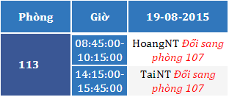
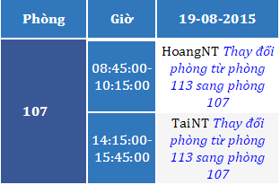
SCENARIO PROBLEM 4
Classroom 113
Damaged Level: 80%
IsDamaged: true
Classroom 306
Damaged Level: 50%
IsDamaged: true
306
Resolve
Classroom 306
Damaged Level: 0%
IsDamaged: false
19-08-2015 12:15 PM

Slide 153
SCENARIO PROBLEM 4
Classroom 113
Damaged Level: 80%
IsDamaged: true
Classroom 306
Damaged Level: 50%
IsDamaged: true
306
Resolve
Classroom 306
Damaged Level: 0%
IsDamaged: false
19-08-2015 12:15 PM

Slide 154
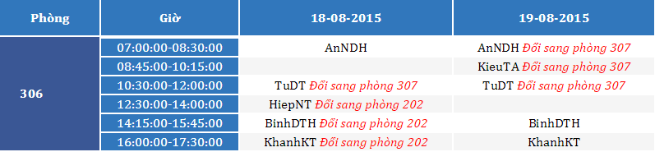
SCENARIO PROBLEM 4
Classroom 113
Damaged Level: 80%
IsDamaged: true
Classroom 306
Damaged Level: 50%
IsDamaged: true
306
Resolve
Classroom 306
Damaged Level: 0%
IsDamaged: false
19-08-2015 12:15 PM
Back to classroom 306

Slide 155
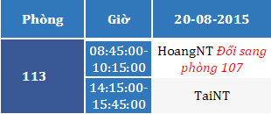
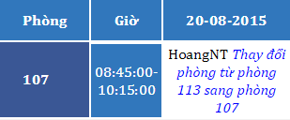
SCENARIO PROBLEM 4
Classroom 113
Damaged Level: 80%
IsDamaged: true
Classroom 306
Damaged Level: 50%
IsDamaged: true
306
Resolve
Classroom 306
Damaged Level: 0%
IsDamaged: false
20-08-2015 06:30 AM

Slide 156
SCENARIO PROBLEM 4
Classroom 113
Damaged Level: 80%
IsDamaged: true
Classroom 306
Damaged Level: 50%
IsDamaged: true
306
Resolve
Classroom 306
Damaged Level: 0%
IsDamaged: false
20-08-2015 06:30 AM

Slide 157
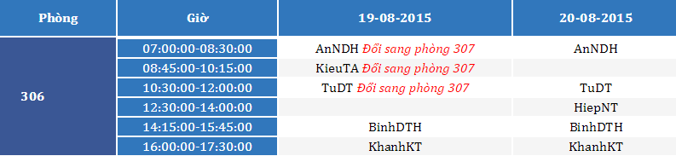
SCENARIO PROBLEM 4
Classroom 113
Damaged Level: 80%
IsDamaged: true
Classroom 306
Damaged Level: 50%
IsDamaged: true
306
Resolve
Classroom 306
Damaged Level: 0%
IsDamaged: false
20-08-2015 06:30 AM
Back to classroom 306

Slide 158
DEMONSTRATION

Slide 159
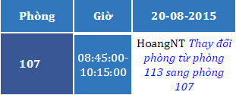
SCENARIO PROBLEM 5
Mr. HoangNT

Slide 160
SCENARIO PROBLEM 5
20-08-2015
09:00 AM
Classroom 107
Speaker: “Không thể sử dụng được”
Evaluate: “Phải đổi phòng”
Mr. HoangNT

Slide 161
SCENARIO PROBLEM 5
20-08-2015
09:00 AM
Classroom 107
Speaker: “Không thể sử dụng được”
Evaluate: “Phải đổi phòng”
Mr. HoangNT

Slide 162
SCENARIO PROBLEM 5
20-08-2015
09:00 AM
Classroom 107
Speaker: “Không thể sử dụng được”
Evaluate: “Phải đổi phòng”
Mr. HoangNT
Analyze data
Classroom 107
Damaged Level: 15%
IsDamaged: true

Slide 163
SCENARIO PROBLEM 5
20-08-2015
09:00 AM
Classroom 107
Speaker: “Không thể sử dụng được”
Evaluate: “Phải đổi phòng”
Mr. HoangNT
Analyze data
Classroom 107
Damaged Level: 0%
IsDamaged: False
Classroom 107
Damaged Level: 80%
IsDamaged: true
Classroom 107
Damaged Level: 15%
IsDamaged: true
Normal
Damaged

Slide 164
SCENARIO PROBLEM 5
107
Get report

Slide 165
SCENARIO PROBLEM 5
107
Classroom 107
Damaged Level: 15%
IsDamaged: true
Get report

Slide 166
SCENARIO PROBLEM 5
107
Classroom 107
Damaged Level: 15%
IsDamaged: true
Get report
Change room
Classroom 107
Damaged Level: 15%
IsDamaged: true
Classroom 602
Damaged Level: 0%
IsDamaged: false

Slide 167

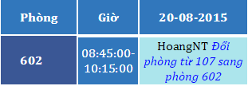
SCENARIO PROBLEM 5
107
Classroom 107
Damaged Level: 15%
IsDamaged: true
Get report
Change room

Slide 168
SCENARIO PROBLEM 5
113
Resolve
Classroom 113
Damaged Level: 0%
IsDamaged: false
Seriously Damaged
Normal

Slide 169

SCENARIO PROBLEM 5
113
Resolve
Classroom 113
Damaged Level: 0%
IsDamaged: false
21-08-2015 06:30 AM
Back to classroom 113

Slide 170
SCENARIO PROBLEM 5
113
Resolve
Classroom 113
Damaged Level: 0%
IsDamaged: false
21-08-2015 06:30 AM
Back to classroom 113

Slide 171
DEMONSTRATION

Slide 173
1
2

Slide 174
1
2
3

Slide 175

4
5
1
2
3

Slide 176
4
5
1
2
3
6
Change Room and Notification

Slide 177
4
5
1
2
3
6
7
Change Room and Notification

Slide 178
4
5
1
2
3
6
8
7
Change Room and Notification

Slide 179
ADVANTAGE & DISADVANTAGE
Advantage
Require less human source
Save time when receive and resolve report
Easy to check status of equipment, classroom
User interface is friendly, easy to use.
Disadvantage
Can not check user behavior.
Only support for Android OS.

Slide 180
FUTURE PLAN
Synchronize schedule with Google Calendar
Support other mobile OS
Optimize sort and find available room algorithms.

Slide 181
Question and Answer

